Slide 1
Python Labs Proposal: Identification of Hypertrophic Cardiomyopathy in Asymptomatic Athletes
DRAFT
Nathalie descusse-brown

Slide 2
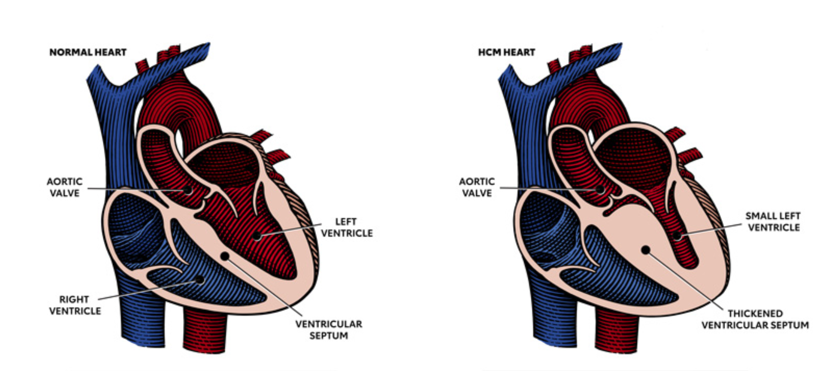
The problem
Source: www.heart.org
What is hypertrophic cardiomyopathy (HCM)?
HCM is most often caused by abnormal genes in the heart muscle. These genes cause the walls of the heart chamber (left ventricle) to contract harder and become thicker than normal.
The thickened walls become stiff. This reduces the amount of blood taken in and pumped out to the body with each heartbeat.
As HCM progresses, it can cause other health problems. People with HCM are at higher risk for developing atrial fibrillation, which can lead to blood clots, stroke and other heart-related complications. HCM may also lead to heart failure. It can also lead to sudden cardiac arrest, but this is rare.
HCM has been cited as the most common reason for sudden cardiac death in young people and athletes under the age of 35 although some more recent paper disputes this.
HCM can be obstructive or non-obstructive

Slide 3
The problem (cont’d)
Symptoms:
Chest pain, especially with physical exertion
Shortness of breath, especially with physical exertion
Fatigue
Arrhythmias (abnormal heart rhythms)
Dizziness
Lightheadedness
Fainting (syncope)
Swelling in the ankles, feet, legs, abdomen and veins in the neck
Why is it an issue particularly for athletes?
Athletes typically will not exhibit the symptoms above as self-selected (i.e. they have been able to reach a certain level of fitness BECAUSE of the absence of symptoms).
If misdiagnosed, HCM will typically lead to the end of intensive training for an athlete, possibly even career.
For some athletes the thickness of the septal wall is in the ‘grey zone’ (end-diastolic wall thickness in the 13-16mm range), meaning there is uncertainty around whether it is caused by HCM or Exercise-induced cardiac remodeling (EICR), also known as athlete's heart as both conditions cause hypertrophy of the left ventricle (LVH).
Exercise cessation for a period of time (detraining) has been prescribed until now to help identify the actual cause of LVH but some study have shown this not to be consistently reliable [1].

Slide 4
Existing literature
The below is an unexhaustive list of available references around this issue:
[1] “Athlete's heart or hypertrophic cardiomyopathy?” by Jörg Lauschke 1, Bernhard Maisch, Clinical Research in Cardiology: The Official Journal of German Cardiac Society, Feb 2009.
[2] “Hypertrophic Cardiomyopathy, Athlete’s Heart, or Both” by Kalie Y. Kebed, J. Martijn Bos, Nandan S. Anavekar, Sharon L. Mulvagh, Michael J. Ackerman, and Steve R. Ommen, Circulation – Cardiovascular Imaging Journal, Vol.8, Issue 7, July 2015.
[3] “The demanding grey zone: Sport indices by cardiac magnetic resonance imaging differentiate hypertrophic cardiomyopathy from athlete’s heart” by Csilla Czimbalmos,Ibolya Csecs,Attila Toth,Orsolya Kiss,Ferenc Imre Suhai,Nora Sydo,Zsofia Dohy,Astrid Apor,Bela Merkely ,Hajnalka Vago, PLOS ONE, Feb 2019.
[4] “Exercise in hypertrophic cardiomyopathy: restrict or rethink by Exercise in hypertrophic cardiomyopathy: restrict or rethink” by Adaya Weissler Snir, Kim A. Connelly, Jack M. Goodman, David Dorian and Paul Dorian, American Journal of Physiology, Mar 2021.
[5] “Left ventricular hypertrophy in athletes” by John Rawlins, Amit Bhan, Sanjay Sharma, European Journal of Echocardiography, Volume 10, Issue 3, May 2009

Slide 5
Status of research
Most of the research in the field appears to be relatively recent (in past 10 years).
Athlete’s heart appears to be associated with eccentric biventricular hypertrophy with wall thicknesses under 15 mm and a moderately dilated left ventricle (LVEDD up to 58 mm). Also it appears that although systolic function in normal in non-HCM athletes and the majority of HCM patients, there are significant differences in dystolic function [1].
Cardiac Magnetic Resonance appears to be the most reliable technique in order to assess heart characteristics needed to classify HCM.

Slide 6
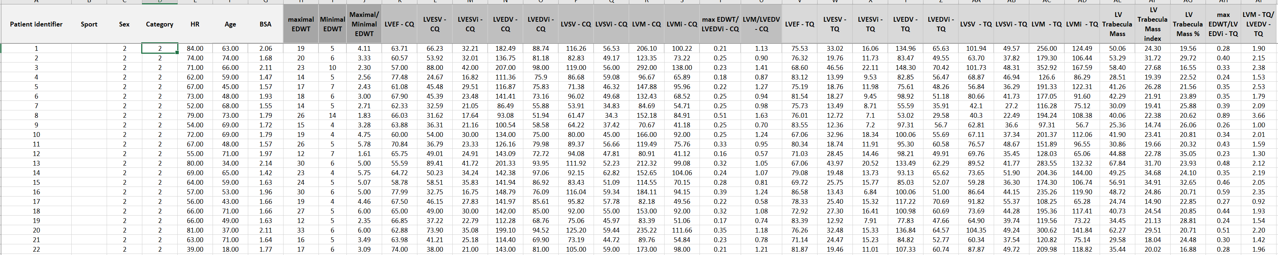
Data
The data proposed for this project comes from literature source [3] and consists of heart and heart function function measurements issued from Cardiac Magnetic Resonance images for 354 patients including 3 types:
Athletes
HCM patients
Athletes with HCM

Slide 7
Potential Challenges
Not much challenge in terms of data cleaning / preparation.
Potential risk that the project will not identify anything new compared to existing research.
Potential risk of misinterpreting the results if no medical background within the team.

Slide 8
The Team
Combination of DS and DE (2 of each).
Ideally someone with medical background.

